Slide 1
Deep Learning

Slide 2
Major Elements
Data
Model/Algorithm
Training
Validation
Inference
Deployment

Slide 3
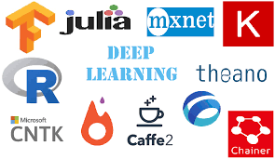
Libraries
Credits: https://www.houseofbots.com/images/news/4015/cover.png

Slide 4
Pytorch
Open source machine learning library based on the Torch library
Used for applications such as computer vision and natural language processing, primarily developed by Facebook's AI Research lab
It is free and open-source software released under the Modified BSD license.
A number of pieces of Deep Learning software are built on top of PyTorch, including Tesla Autopilot, Uber's Pyro, HuggingFace's Transformers, PyTorch Lightning, and Catalyst.

Slide 5
Tensorflow
TensorFlow is a free and open-source software library for machine learning.
It can be used across a range of tasks but has a particular focus on training and inference of deep neural networks.
It is a symbolic math library based on dataflow and differentiable programming.
It is used for both research and production at Google.

Slide 6
Mxnet
Apache MXNet is an open-source deep learning software framework, used to train, and deploy deep neural networks.
It was co-developed by Carlos Guestrin at University of Washington (along with GraphLab).
Amazon has chosen MXNet as its deep learning framework of choice at AWS.

Slide 7
Which one to use?
No standard rules as such

Slide 8
Pytorch Main Module
Tensor Functions
Matrix Functions
Network save and load Functions

Slide 9
Colab - Pytorch Main Module

Slide 10
Pytorch Mathematical Operations
Scalar additions and subtractions
Trigonometric functions
Statistical functions
Comparison and logical operators
Non linear Functions

Slide 11
Colab - Mathematical Functions

Slide 12
Colab - Linear Algebraic Functions
https://upload.wikimedia.org/wikipedia/commons/thumb/3/3c/Mona_Lisa_eigenvector_grid.png/480px-Mona_Lisa_eigenvector_grid.png
https://www.mathsisfun.com/algebra/images/eigen-transform.svg

Slide 13
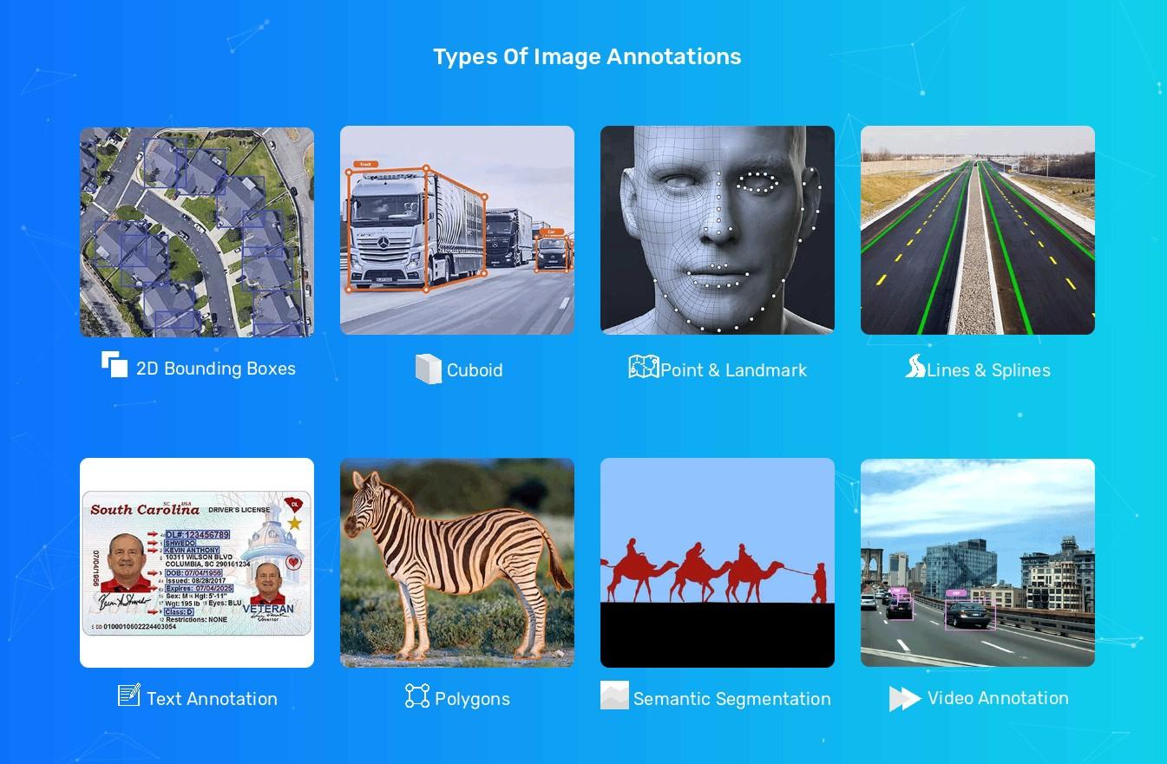
Data - Images and Annotations
redits:
Single Label
Multi Label
Video Snippet
Bounding box
Semantic Segmentation
Instance Segmentation
Keypoints
Credits: https://miro.medium.com/max/2690/1*KzFtlg5j2HASwYaHwb9ZgQ.jpeg

Slide 14
Dataset - Preprocessing
Noise Removal or addition
Intensity Variations
Blurring and deblurring
Morphological operations
https://github.com/MaybeShewill-CV/attentive-gan-derainnet
https://github.com/thatbrguy/Dehaze-GAN

Slide 15
Dataset - Artificial Augmentation
Avoid class imbalance
Increase size of dataset
Bring variations to dataset artificially

Slide 16
Colab - Transformers Demo

Slide 17
Data Loaders
To seamlessly handle huge datasets

Slide 18
Colab - Data Loaders

Slide 19
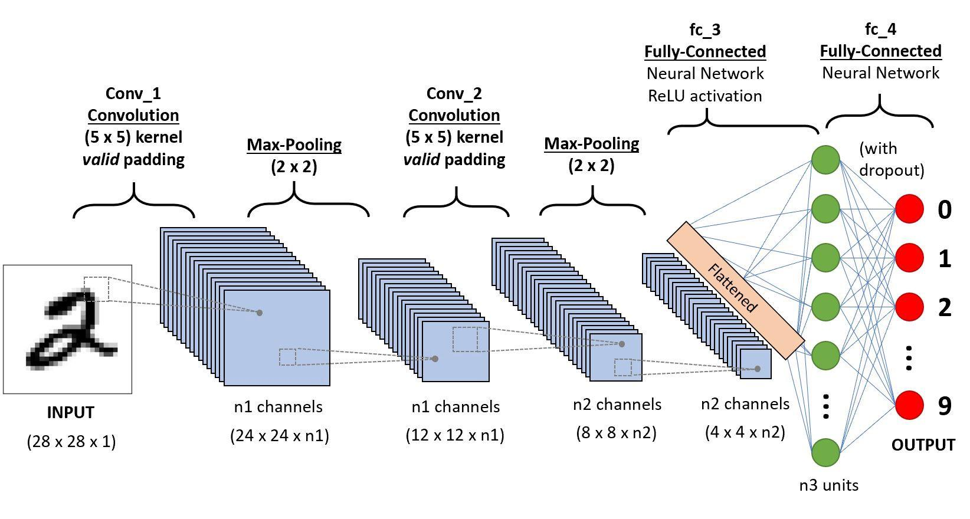
Layers
A layer is the highest-level building block in deep learning.
A layer is a container that usually receives weighted input, transforms it with a set of mostly non-linear functions and then passes these values as output to the next layer.
Credits: https://miro.medium.com/max/3288/1*uAeANQIOQPqWZnnuH-VEyw.jpeg

Slide 20
Convolutions & Poolings
1D convolution
2D convolution
Transposed convolution
Average pooling
Max pooling
Fractional pooling
Adaptive pooling
Global pooling

Slide 21
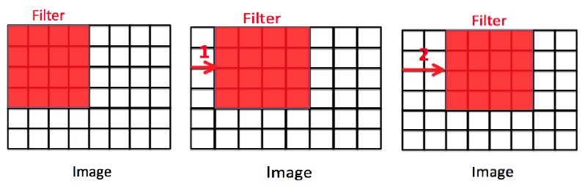
Convolution Filter
Second method: (((W - K + 2P)/S) + 1)
Here W = Input size
K = Filter size
S = Stride
P = Padding

Slide 22
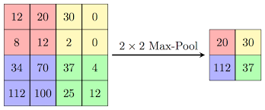
Pooling Layers
Credits: https://computersciencewiki.org/images/8/8a/MaxpoolSample2.png

Slide 23
Colab - Convolution Pooling Demo
Credits: https://miro.medium.com/max/2560/1*ciDgQEjViWLnCbmX-EeSrA.gif

Slide 24
Layers DEMO
https://poloclub.github.io/cnn-explainer/
https://www.cs.ryerson.ca/~aharley/vis/conv/

Slide 25
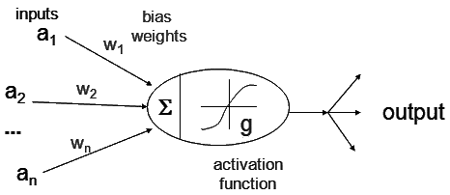
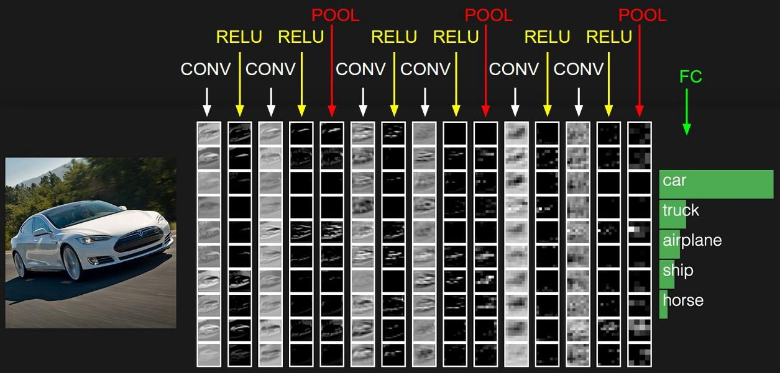
Activations

Slide 26
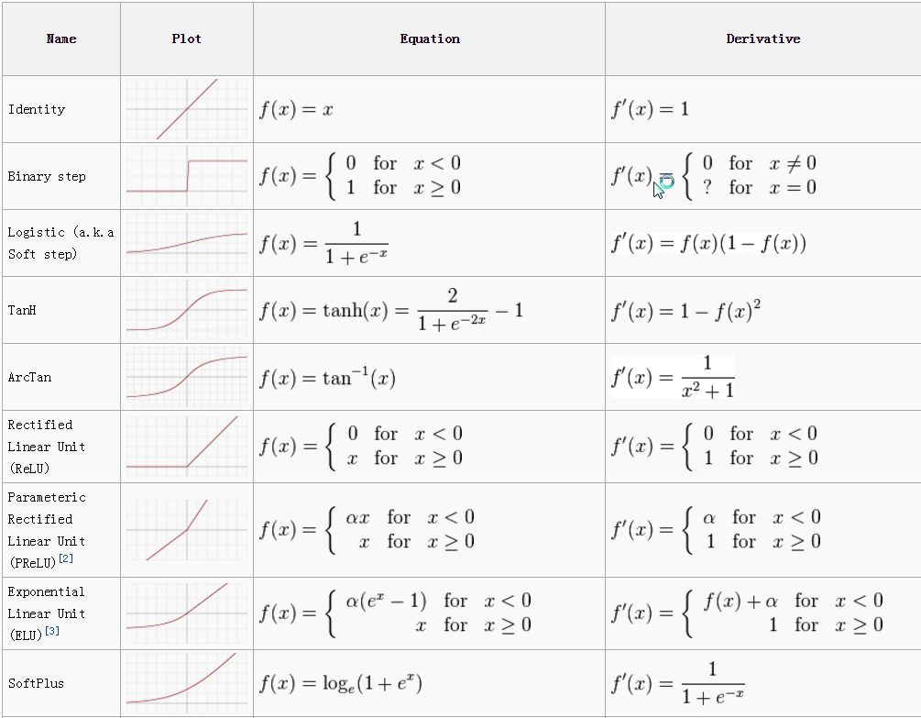
Activations
Credits: https://miro.medium.com/max/2010/1*p_hyqAtyI8pbt2kEl6siOQ.png

Slide 27
Colab - Activations Demo

Slide 28
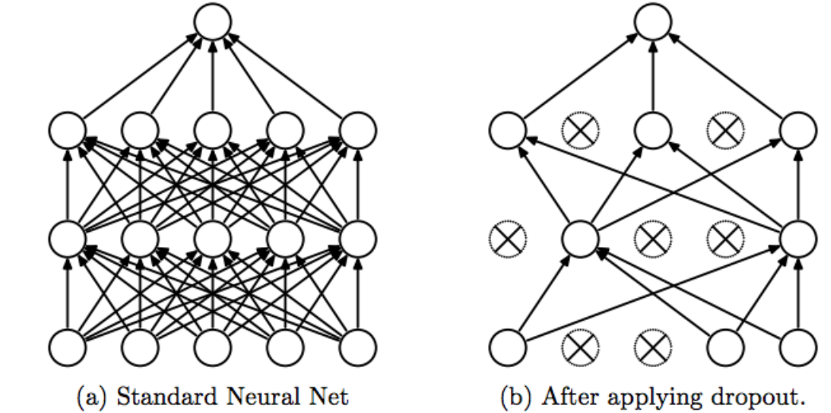
Dropout
Credits: https://miro.medium.com/max/875/1*iWQzxhVlvadk6VAJjsgXgg.png

Slide 29
Colab - Dropouts Demo

Slide 30
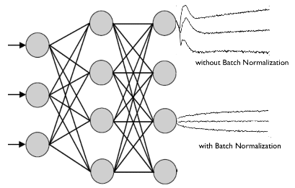
Normalization
Credits: https://charlesmartin14.files.wordpress.com/2017/06/batchnorm2-e1497643748774.png?w=640

Slide 31
Colab - Normalization

Slide 32
Initializers
https://www.deeplearning.ai/ai-notes/initialization/

Slide 33
Colab - Initializers Demo

Slide 34
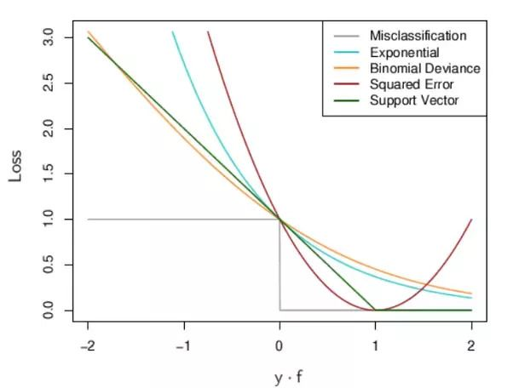
Losses
Credits: https://raw.githubusercontent.com/rohan-varma/rohan-blog/gh-pages/images/loss3.jpg

Slide 35
Colab - Losses Demo

Slide 36
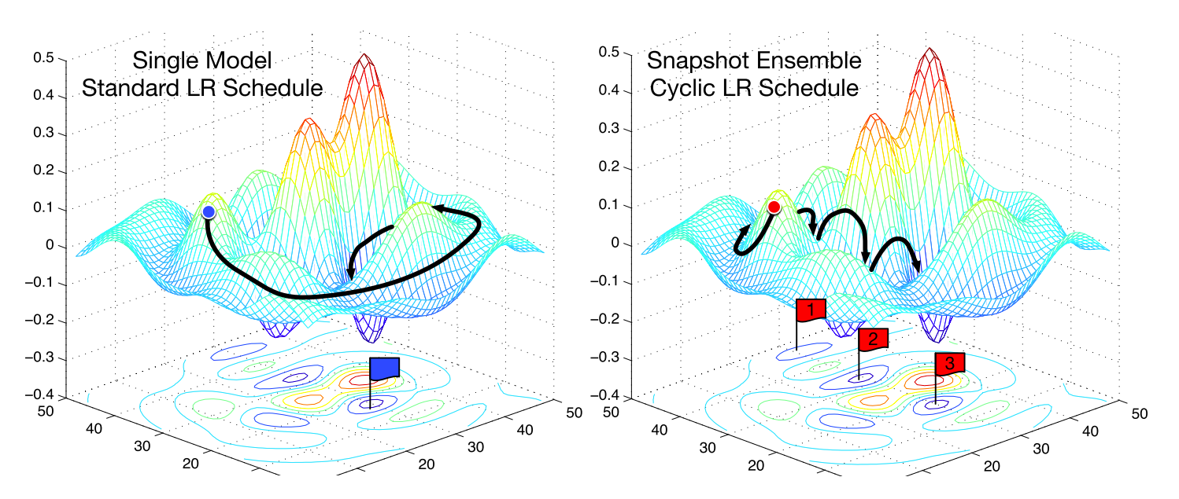
Optimizers
Credits: https://ruder.io/content/images/size/w2000/2017/12/snapshot_ensembles.png

Slide 37
Colab - Optimizers Demo

Slide 38
Colab - Network Stacks

Slide 39
Model Families - Alexnet
https://github.com/Tessellate-Imaging/monk_v1/blob/master/study_roadmaps/2_transfer_learning_roadmap/5_exploring_model_families/1_alexnet/1)%20Alexnet%20-%20mxnet%20backend.ipynb
https://miro.medium.com/max/3688/1*eBDriuBwa5O8HPFUgerklA.png

Slide 40
Model Families - VGG
https://github.com/Tessellate-Imaging/monk_v1/tree/master/study_roadmaps/2_transfer_learning_roadmap/5_exploring_model_families/2_vgg
https://www.researchgate.net/publication/328966158/figure/fig2/AS:693278764720129@1542301946576/An-overview-of-the-VGG-16-model-architecture-this-model-uses-simple-convolutional-blocks.png

Slide 41
Model Families - Inception
https://github.com/Tessellate-Imaging/monk_v1/tree/master/study_roadmaps/3_image_processing_deep_learning_roadmap/3_deep_learning_advanced/1_Blocks%20in%20Deep%20Learning%20Networks
https://cdn.analyticsvidhya.com/wp-content/uploads/2018/10/googlenet.png

Slide 42
Model Families - Resnet and ResNext
https://github.com/Tessellate-Imaging/monk_v1/tree/master/study_roadmaps/2_transfer_learning_roadmap/5_exploring_model_families/4_resnet
https://miro.medium.com/max/1392/1*7JzJ1RGh1Y4VoG1M4dseTw.png

Slide 43
Model Families - Mobilenet
https://github.com/Tessellate-Imaging/monk_v1/tree/master/study_roadmaps/3_image_processing_deep_learning_roadmap/3_deep_learning_advanced/1_Blocks%20in%20Deep%20Learning%20Networks
https://www.google.com/url?sa=i&url=https%3A%2F%2Ftowardsdatascience.com%2Freview-mobilenetv1-depthwise-separable-convolution-light-weight-model-a382df364b69&psig=AOvVaw2iL6Ja8UGKARKbcWorJW4X&ust=1614510335758000&source=images&cd=vfe&ved=0CAIQjRxqFwoTCKj2j-v1ie8CFQAAAAAdAAAAABAD

Slide 44
Model Families - Densenet
https://github.com/Tessellate-Imaging/monk_v1/tree/master/study_roadmaps/3_image_processing_deep_learning_roadmap/3_deep_learning_advanced/1_Blocks%20in%20Deep%20Learning%20Networks
https://pytorch.org/assets/images/densenet1.png

Slide 45
Model Families - Other Models
https://github.com/osmr/imgclsmob
Senet - https://miro.medium.com/max/2580/1*-UztHZDZEYb35TZBtfvqeA.png
Squeezenet - https://miro.medium.com/max/1122/1*dVaL1bcv5Ewpz-wen7IXCA.png

Slide 46
Next
Simple Image classification
Image classification using Monk
Validation Metrics
Object detection using Monk
GANs

